Slide 1
ELEMENTS OF VISUAL PERCEPTION

Slide 2
OVERVIEW
Structure of the human eye
Image formation in the eye
Brightness adaptation and discrimination
Mach band effect and Simultaneous contrast
Optical illusion

Slide 3
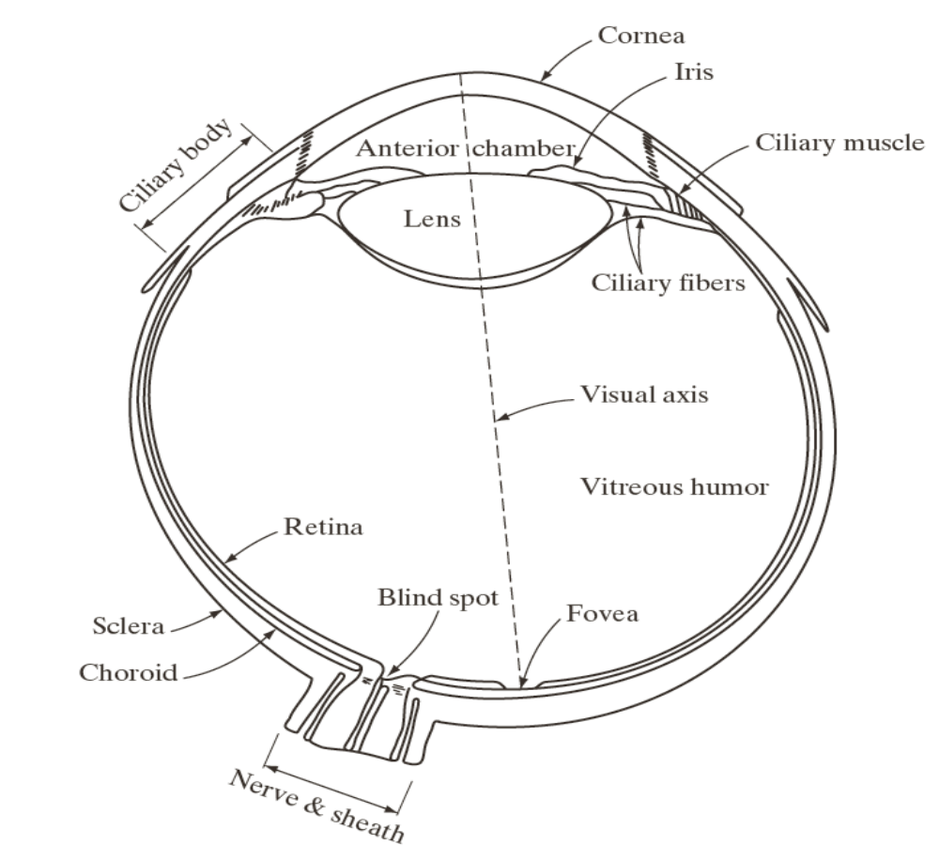
STRUCTURE OF THE HUMAN EYE

Slide 4
STRUCTURE OF THE HUMAN EYE
Digital images are processed for enhanced visual perception by humans. It is important to understand how humans perceive images.
The eye nearly sphere in shape
  Measures diameter of 20 mm
  Three membranes enclose the eye
    Cornea and sclera (outer cover)
    Choroid
    Retina

Slide 5
STRUCTURE OF THE HUMAN EYE
Cornea:
  The anterior of the eye has the outer coating called cornea
  The cornea is a transparent, curved, refractive window through which the light enters the eye.
  It connects to larger portion, sclera which covers the posterior portion of the optic globe
  Cornea and Sclera are connected by a ring called the limbus.

Slide 6
STRUCTURE OF THE HUMAN EYE
Choroid :
  Beneath the sclera is a membrane called choroid.
  Contains blood vessels to nourish the cells in the eye.
  Heavly pigmented and helps reducing the amount of light entering the eye from any other direction other than the pupil.
  Anterior exterme of the chorid divides into ciliary body and Iris diaphragm.
  Iris:
  Contracts and expands to control the amount of light that enters the eye.
  Front of the iris contains the visible pigment whereas back contains a black pigment.

Slide 7
STRUCTURE OF THE HUMAN EYE
  Pupil:
  It is the opening at the center of the iris.
  Its diameter varies from 1 to 8 mm in response to illumination changes.
  In low light conditions it dilates to increase the amount of light reaching the retina.
  Behind the pupil is the lens of the eye.
  Lens:
  Made of concentric layers of fibrous cells, suspended by fibers attaching the ciliary body
  Contains 60 – 70% water, 6% fat and more protein
  Colored by yellow pigmentation and increases with age
  Lens absorbs 8% of visible light spectrum

Slide 8
STRUCTURE OF THE HUMAN EYE
Retina:
  The innermost membrane of the eye where the light entering the eye is sensed by the receptor cells.
  The retina has 2 types of photoreceptor cells- rods and cones.
  When the eye is properly focussed retina helps in formation of image
Cones:
  There are about 6 million cones in the eye.
  The cones help in the bright-light (photopic) vision, highly sensitive to color.
  Located primarily in the fovea (center portion of retina) where the image is focused by the lens.
  Each cone cell is connected to its separate nerve ending and have the the ability to resolve fine details.

Slide 9
STRUCTURE OF THE HUMAN EYE
Rods:
  100 million rods in the eye.
  Helps in the dim-light (scotopic) vision.
  They are distributed over a larger area in the retina.
  Not involved in color vision.
  Cannot resolve fine spatial detail because many rods are connected to a single nerve.
Blind spot:
  Though the photo-receptors are distributed in radially symmetric manner about the fovea,
  Region near the fovea where there are no receptors. This region is called as the blind spot.
  This is the region where the optic nerve emerges from the eye.
  Light falling on this region cannot be sensed.

Slide 10
STRUCTURE OF THE HUMAN EYE
Eye lens is flexible
Radius of curvature at the anterior surface is greater than the posterior
The shape is controlled by the tension in the fibers of the ciliary body
Lens become thicker to view objects near the eye and flattened to view the farthest.
Focal length varies from 17mm to 14mm
Farthest – less refractive
Closest – strongly refractive

Slide 11
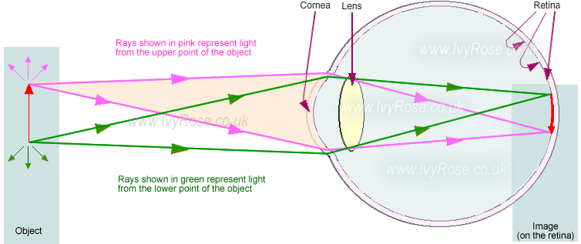
IMAGE FORMATION

Slide 12
BRIGHTNESS ADAPTATION AND DISCRIMINATION
Digital images are displayed as a discrete set of intensities, the eye’s ability to discriminate these variations matters .
The range of light intensity levels for which the human eye can adapt is around 10¹⁰ from scotopic to glare limit.
The total range of distinct intensity levels it can discriminate simultaneously is small when compared to total adaption range.
The sensitivity level for a given lighting condition is called as the brightness adaption level.
The response of the visual system can be characterized with respect to a particular brightness adaption level.

Slide 13
BRIGHTNESS ADAPTATION AND DISCRIMINATION
Brightness discrimination:
The ability of eye to discriminate between changes in light intensity at any specific adaptation level.
The discriminability of the eye also changes with the brightness adaption level.
If the background illumination I is less, the ability of the eye to discriminate a small change in intensity is less.
Larger increment in intensity △I is required for the eyes to be able to discern it if the ambiance illumination I is low.
However if the background illumination is
at a higher level, the eye has a better discrimination, i.e. a smaller △I is required for the eyes to discern it.

Slide 14
BRIGHTNESS ADAPTATION AND DISCRIMINATION
The ratio △I/I is called as the Weber ratio.
Smaller value of the Weber ratio → better discrimination at that brightness adaptation level
Larger value of the Weber ratio –> poor discrimination
This leads to interesting phenomena like Mach band effect and Simultaneous contrast.

Slide 15

Mach Band Effect
Mach bands is an optical illusion named after the physicist Ernst Mach. It exaggerates the contrast between edges of the slightly differing shades of gray, as soon as they contact one another, by triggering edge-detection in the human visual system.
Although the intensity of the stripes is constant, we actually perceive a brightness pattern that is strongly near the boundaries.
The visual system tends to undershoot or overshoot around the boundary of regions of different intensities.

Slide 16
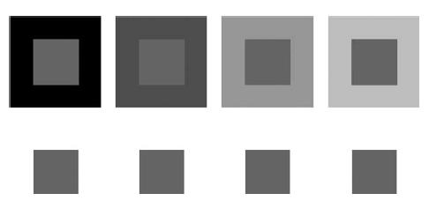
Simultaneous contrast
A region’s perceived brightness does not depend simply on its intensity.
They appear to the eye to become darker as the background gets lighter.

Slide 17
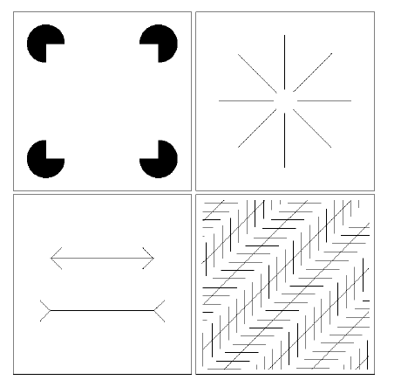
Optical Illusions

